Slide 1
Opening a Chain Restaurant
Xuan Zhao

Slide 2
Intro
Background:
Nowadays, more and more stores have chain stores across the country even across the world. When opening a new chain store in a new place, some brands got a great success, which means they have lots of customers, but some brands failed since those places maybe not suitable for them. Failure is fatal for some companies, especially those companies that are just starting out. They may invest a lot of money to establish a new store, but once the new store failed, they face quite serious cash flow problems which may make them bankrupt. Thus opening a new chain store is risk taking action for every company. If we can analyze our data to find better place to open the new store, then the risk will be decreased.

Slide 3
Intro
Description of the problem:
In this project, we will focus on a restaturant who has a great success in the New York City and wants to open a new chain restaturant in Los Angeles. We will help this restaturant to find best place in the Los Angeles so that the risk of opening a new restaturant will be lower. The reason of chosing these two places, New York City & Los Angeles, is that both of them contain various types of stores and people from all over the world. We only focus on the restaurant here, but theory is same for other stores like clothing, shoping mall, liquor store, etc.

Slide 4
Data
FourSquare Location Data:
By using Foursquare location data, we can extract neighborhoods of the restaurant we are focusing on. Then after segmenting area of Los Angeles, for each location, we can use Foursquare location data again to explore the neighborhoods and find the optimal place with most similar neighborhoods.

Slide 5
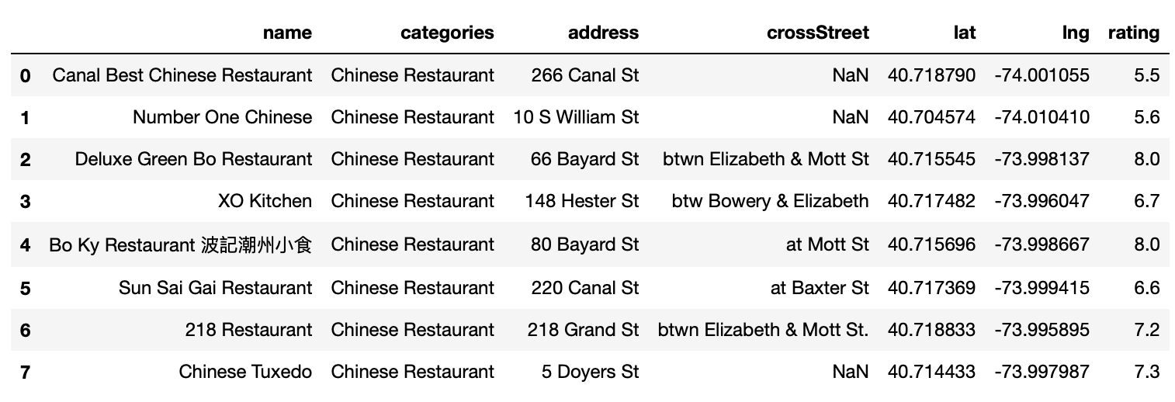
Find a good chinese restaurant
Fous on this first
No "Deluxe Green Bo Restaurant" in Los Angeles, so we will focus on this restaurant to do further exploration.

Slide 6
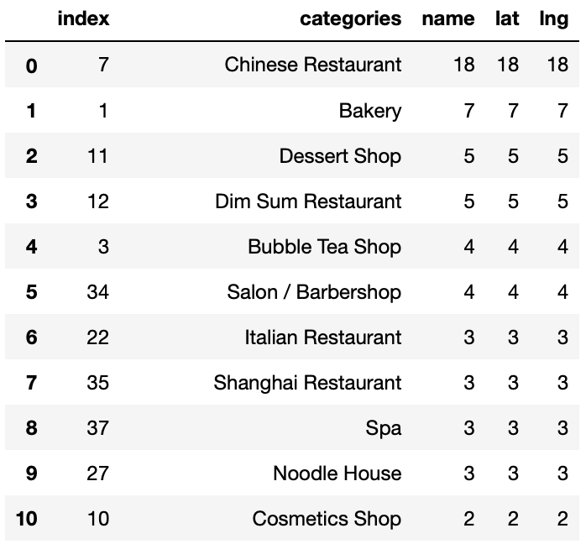
Find an optimal place for "Deluxe Green Bo Restaurant"
Important Categories

Slide 7
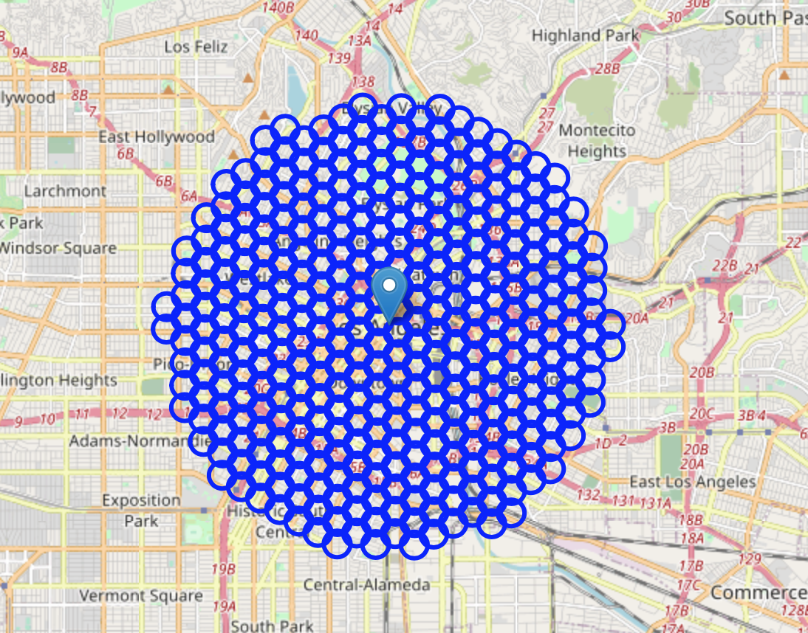
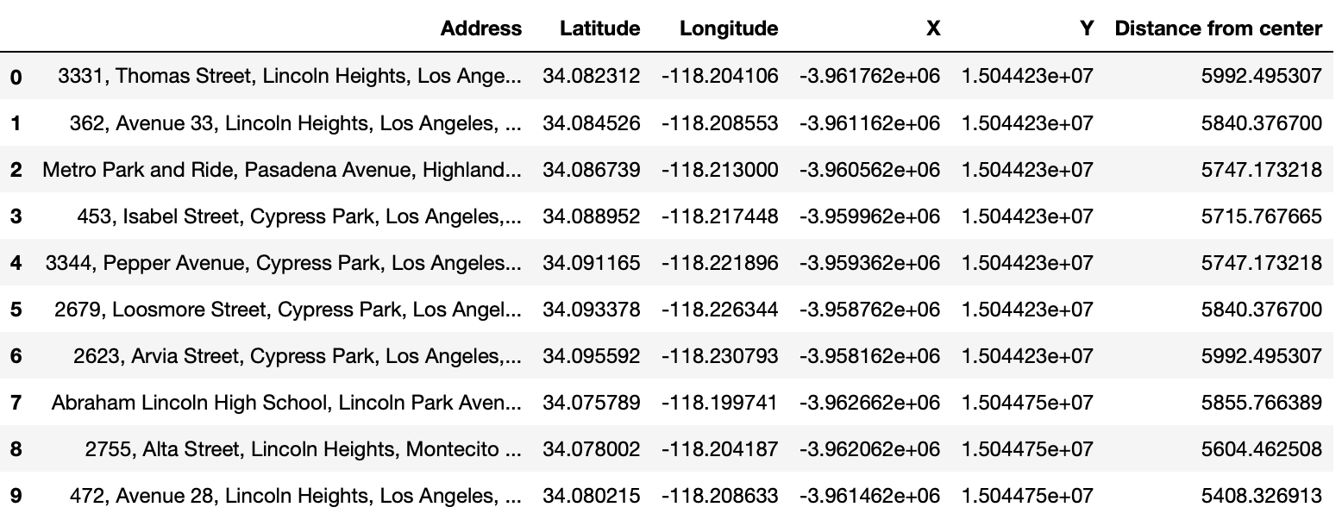
Find an optimal place for "Deluxe Green Bo Restaurant"
Map of city center location and candidate neighborhood centers
Addresses of those locations (364 rows, just show 10 rows here)

Slide 8
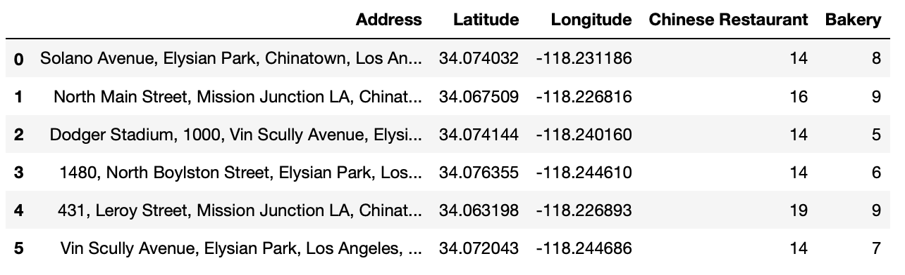
Find an optimal place for "Deluxe Green Bo Restaurant"
After filtering two most important categories, six locations left.

Slide 9
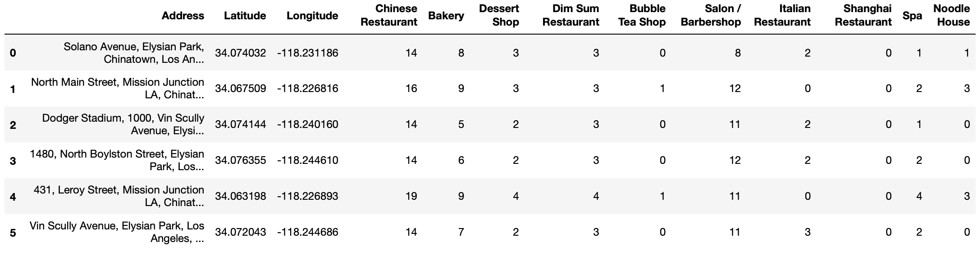
Find an optimal place for "Deluxe Green Bo Restaurant"
Locations after filtering with all categories

Slide 10
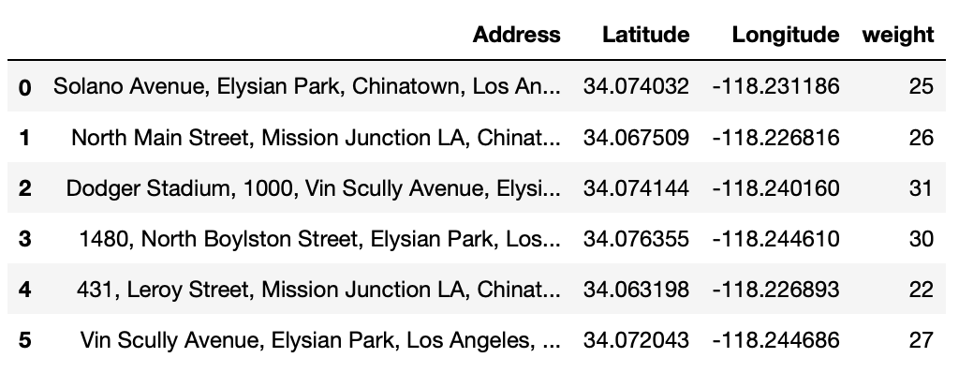
Find an optimal place for "Deluxe Green Bo Restaurant"
Locations after filtering with weight
Lowest weight shows most similar neighborhoods with restaurant in NY, so "431, Leroy Street, Mission Junction LA" should be a optimal location.

Slide 11
Results and Discussion
From above we can see that, we got six places that satisfy our first two categories: "Chinese Restaurant" and "Bakery", which means that these six places have similar number of venues with those categories nearby. Combining other eight categories and calculating the weight, we find that the optimal place should be "431, Leroy Street, Mission Junction LA" with latitude 34.063198 and longitude -118.226893 since it has smallest number on weight so that it has most similar neighborhoods as restaurant in New York City. Thus, if "Deluxe Green Bo Restaurant" wants to open a chian restaurant in Los Angeles, then opening arond "431, Leroy Street, Mission Junction LA" should be a optimal choice.

Slide 12
Conclusion
Purpose of this project is to find a optimal location for a successful Chinese restaurant in New York to open a chain restaurant in Los Angeles. The first process for this project is to find a good restaurant to focus on, but if you have already know which brand you want to focus (not just restaurant, but also stores or any brands), then you can skip the first process. After deciding the restaurant to focus, we explored the neighborhoods of this restaurant, and then try to find a place in Los Angeles that has similar number of categories of neighborhoods. After analysis, we find that "431, Leroy Street, Mission Junction LA" is a optimal place for "Deluxe Green Bo Restaurant" to open a chain restaurant.

Slide 13
Thank you!

